Slide 1
Supporting a Rule 11 Classroom

Slide 2
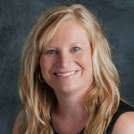
Hello!
I am Michele Rayburn.
ESU6 Director of Student Services
michele.rayburn@esu6.org

Slide 3
Objectives For Our Time Together
Rule 11 Overview
Rule 11 Professional Development Requirements
Meaningful Professional Development
Resources

Slide 4
1.
Rule 11

Slide 5
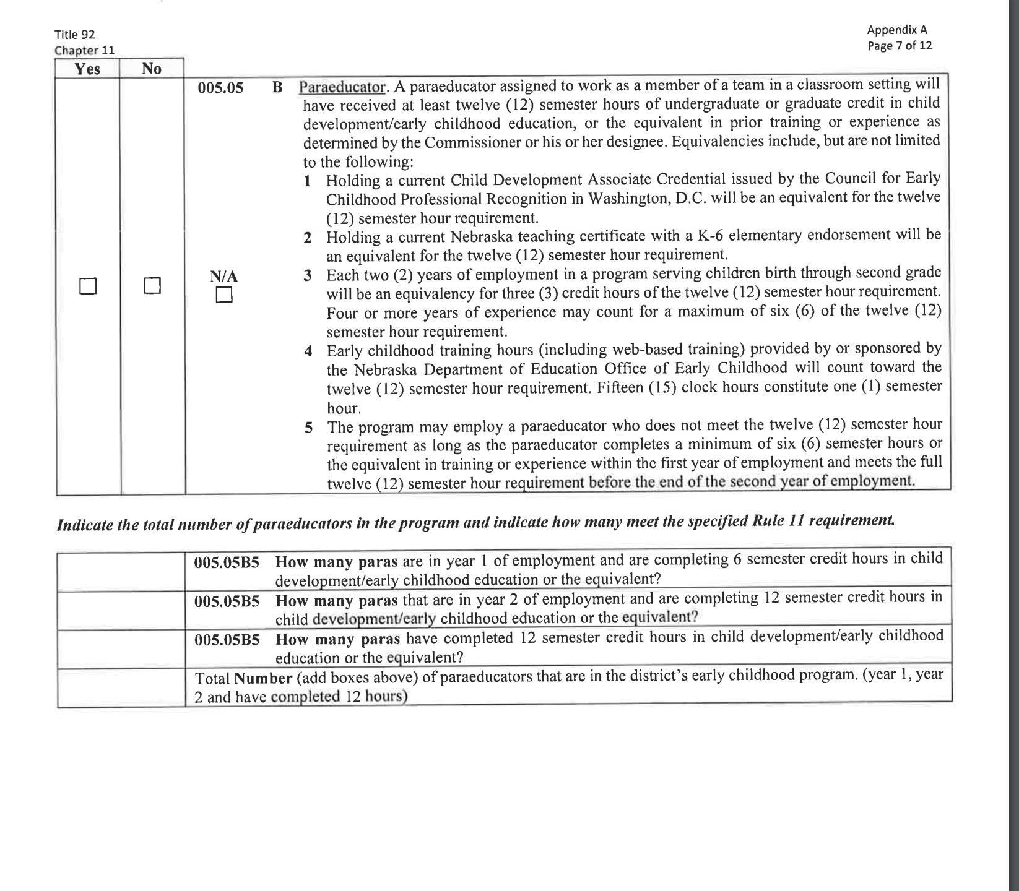
Rule 11

Slide 6
2.
Para PD Requirement

Slide 7
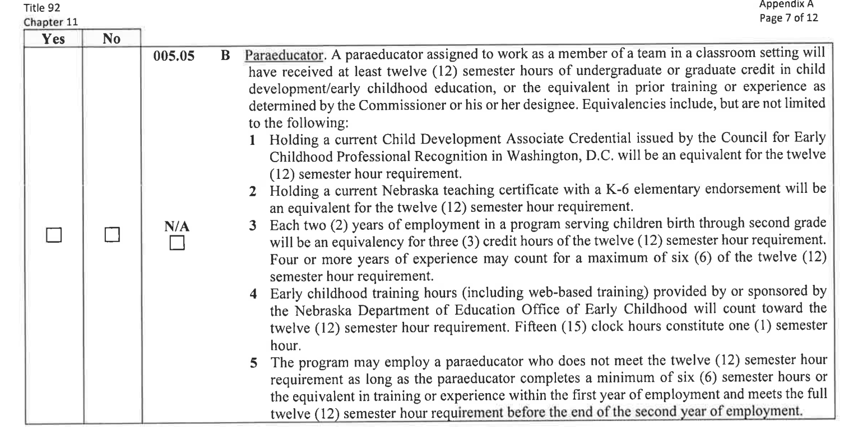
Required Hours - Initial

Slide 8
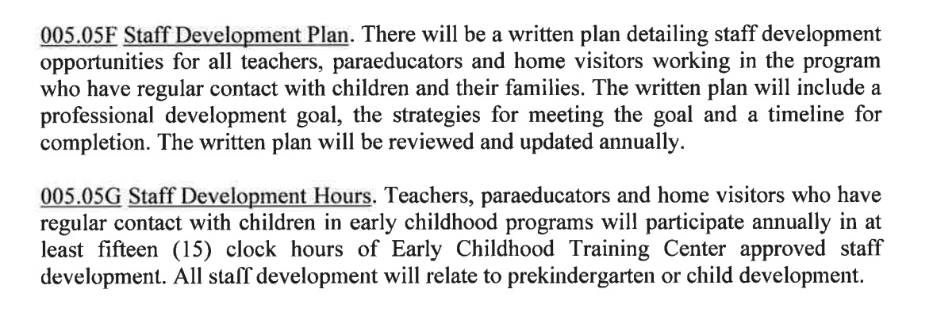
Required Hours - Ongoing

Slide 9
3.
PD Planning

Slide 10
Big Topics
Early Learning Guidelines - What we teach
ECERS - How we set up the environment
CLASS - How we set up our interactions
GOLD - How we assess progress toward domains and design instruction
Pyramid - Reducing/addressing Challenging Behavior
Individual Goal Setting

Slide 11
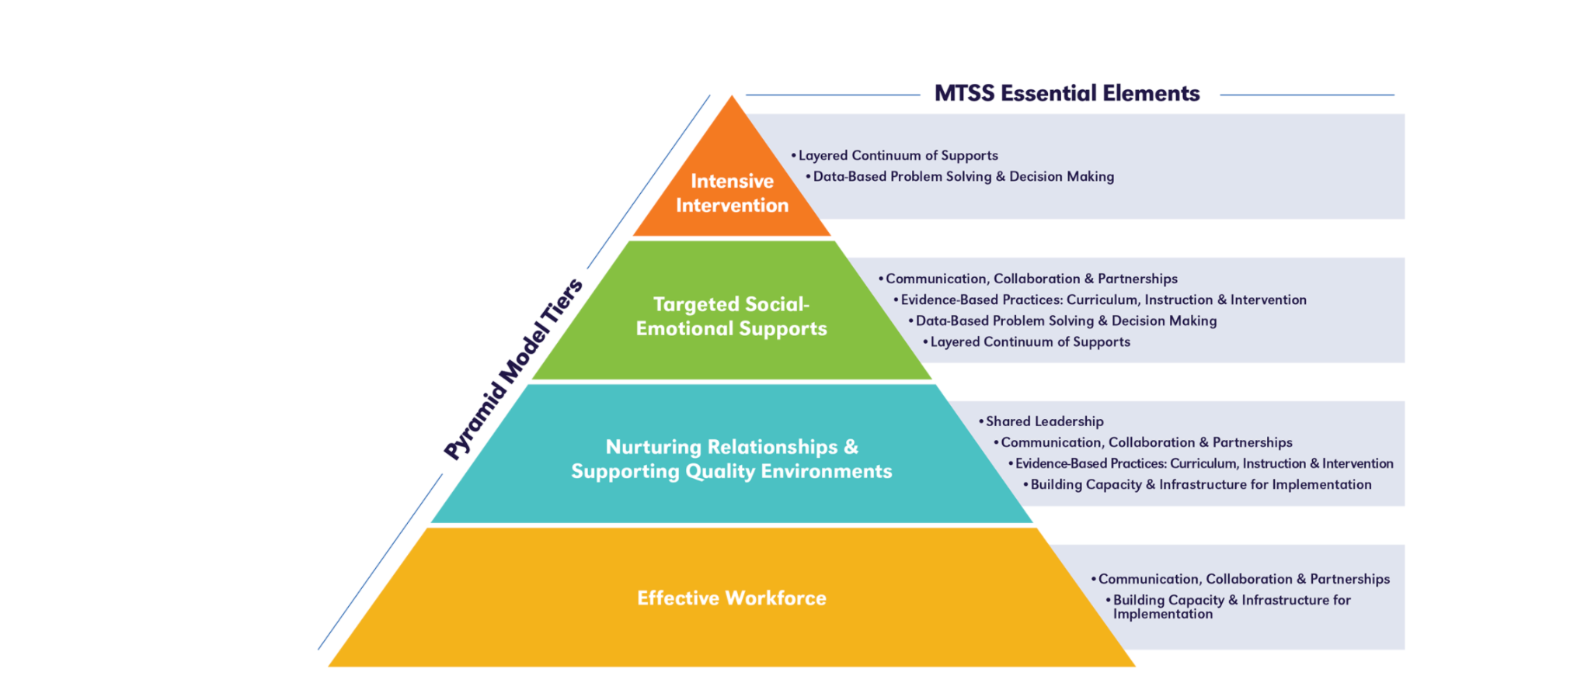
Foundations

Slide 12
Some Specifics
How do we stay connected with each other and our purpose?
Teaming - how/when?
Consistent
Ongoing

Slide 13
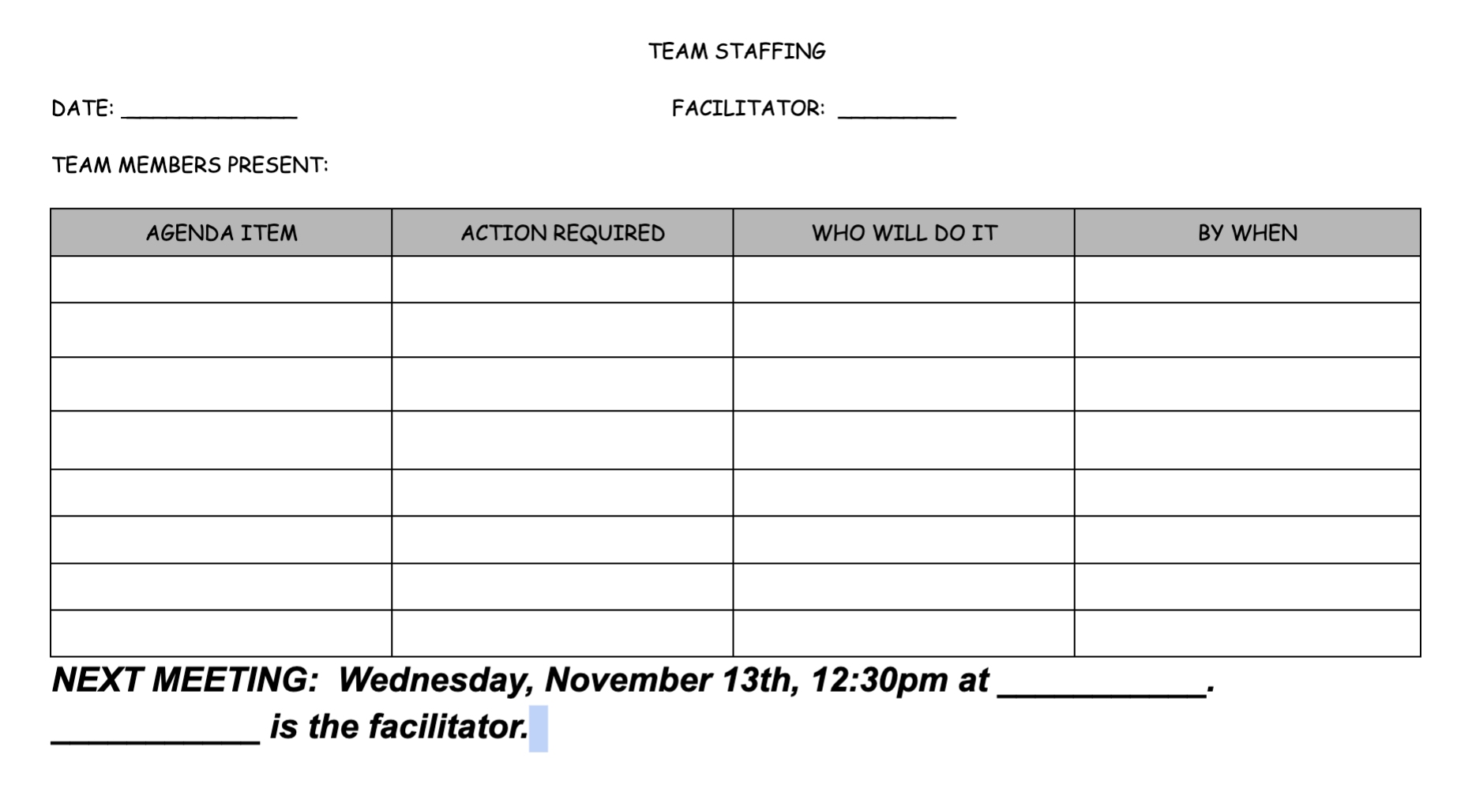
Some Tools to Help
Meeting Agenda
Shared drive

Slide 14
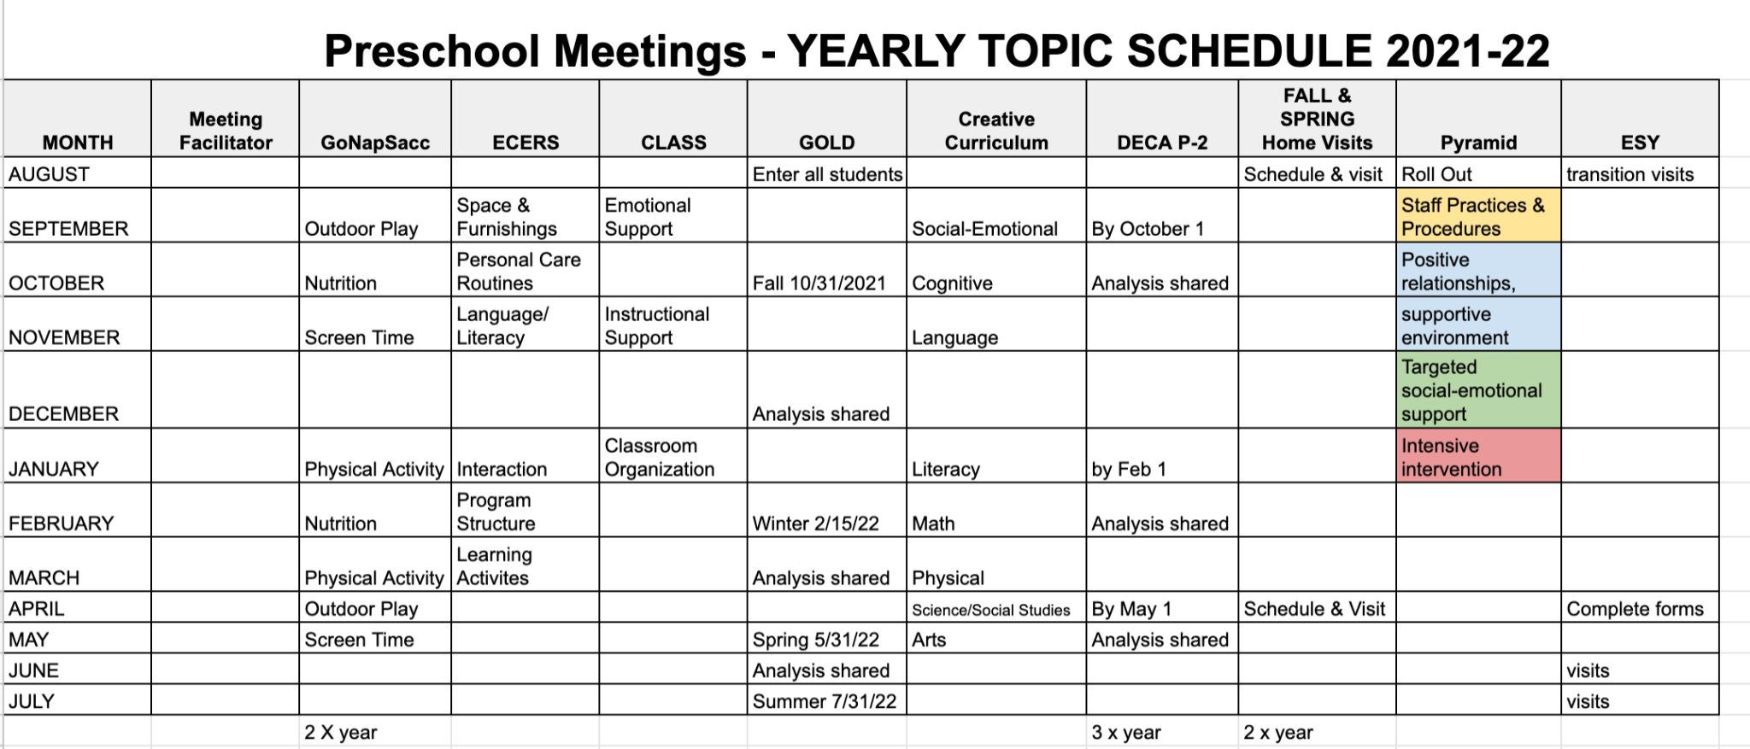
Rotation of Relevant Topics
Annual Calendar

Slide 15
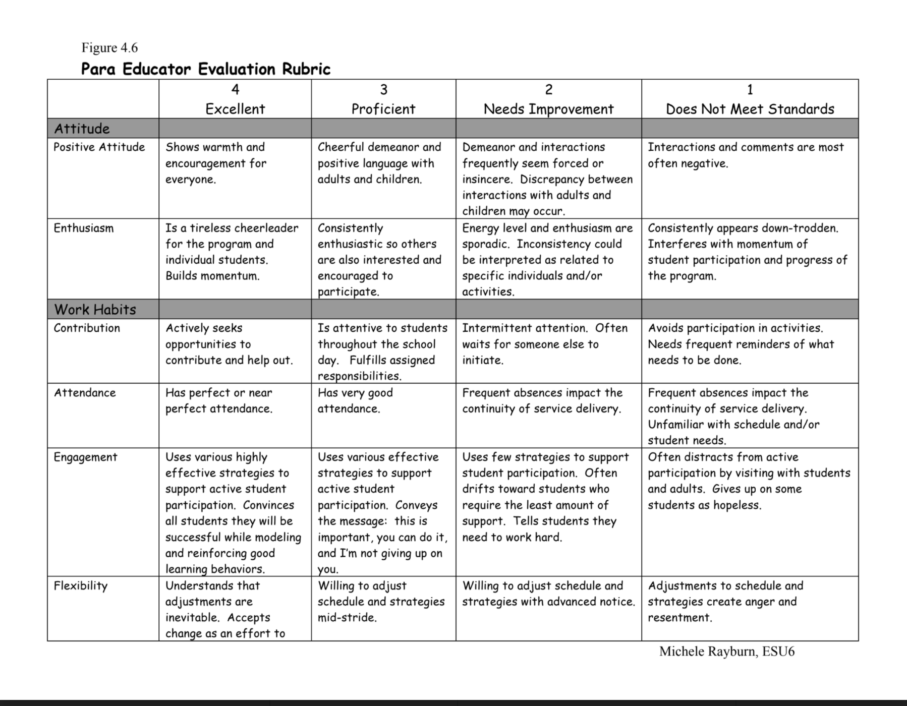
Individual Reflection and Goal Setting
Rubric

Slide 16
Questions?

Slide 17
Thanks!
Any questions?
You can find me at:
michele.rayburn@esu6.org

