Slide 1
WHAT’S IN IT FOR ME?
Reinforcement Strategies that Work
Presented by Matthew McNiff, Ph.D.
Behavior Consultant

Slide 2
Let’s talk reinforcement!!

Slide 3
Why Use Reinforcement?
I’m glad you asked.
Punishment works but reinforcement is better
Encourages the use of the positive behavior in the future
Reduces problematic behaviors
Makes the student more accountable to school staff and themselves

Slide 4
Why should I reward kids for doing what they already should be doing anyway?

Slide 5
The Paycheck

Slide 6
Types of Positive Reinforcement
Natural and Direct Reinforcement
Social Reinforcers
Activity Reinforcers
Tangible Reinforcers
Token Reinforcement

Slide 7
Determining a Reinforcer
Find what the child does when they have free time
Ask the students what they would like
Use a reinforcement menu
Pair the reinforcer with positive praise

Slide 8
Your Best And Easiest Reinforcement: PRAISE!!!

Slide 9
When you Praise . . .
Make it behavior specific
Praise should tell students what TO do instead of what NOT to do
Address what they are doing instead of what they are not doing
Behavior specific praise teaches the student and those around them the expectations

Slide 10
Praise the Student (Continued)
Use a 4:1 ratio of positive comments to criticisms
Strategies to increase praise
Cueing (Timer, PA System, Visual Cues)
Self Monitoring (Pennies, Marks, Tokens)
Student Recruiting – Asking adult if they are doing a good job
Performance Feedback (Checking rate against other staff, supervisor, public posting)
Written
Self-record and Goal Setting
Experiment with praise types
Sandwich praise
Nonverbal and verbal codes (thumbs up)
Traditions and ceremonies (round of applause, big hand)

Slide 11
Reinforcement Schedules
Types of Reinforcement Schedules
Chart Moves
Compliance Matrix (Behavior Bingo)
Lottery
Token Economy
Hero Procedure
Reverse Clip Chart

Slide 12
Chart Moves
This is simply a connect the dot chart that connects dots when appropriate behaviors are performed.
Child is reinforced when they reach milestones on the chart or complete the chart.
This is an excellent way of using a visual graph to increase positive behaviors.
It allows children to see their progress thus creating internal reinforcement while also creating external reinforcement through the reward they receive
Notes:
Can be used for both individual and group.
Homework completion
Lining up
Paying attention
In seat
Latency programming like how long it takes to get started.

Slide 13
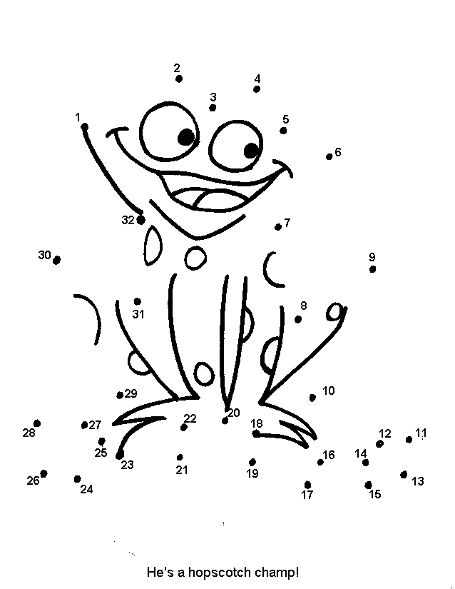
Chart Moves

Slide 14
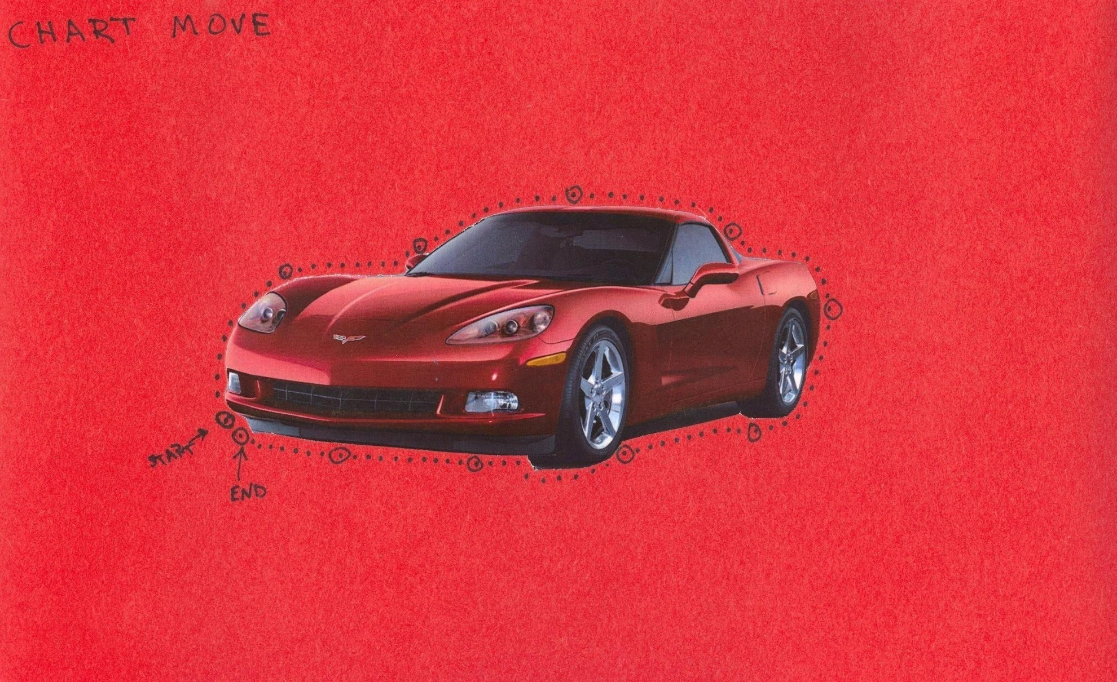
Home Made Chart Move

Slide 15
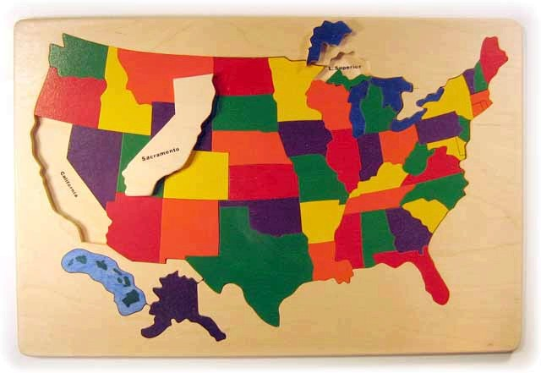
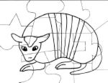
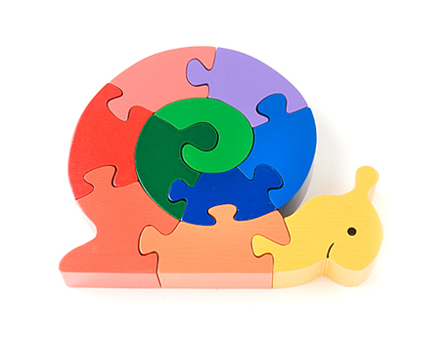
Puzzle Picture Motivator

Slide 16
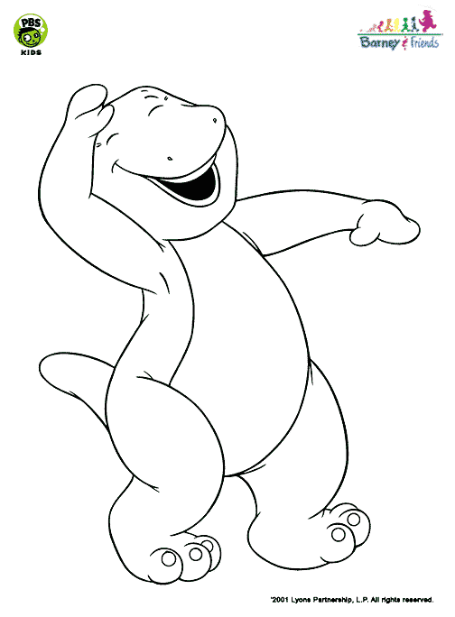
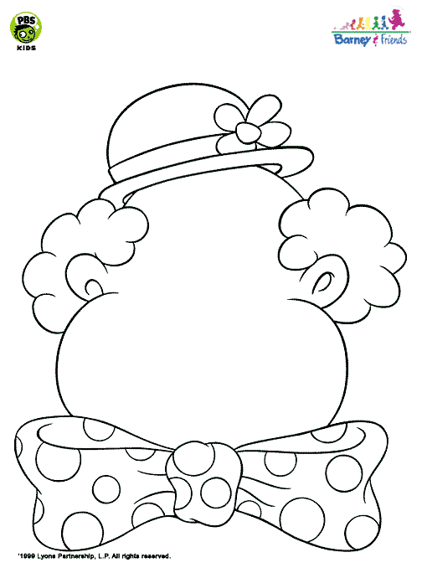
Coloring Book Page/Picture Drawing

Slide 17
Coloring Book Page

Slide 18
Picture Drawing

Slide 19
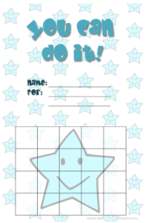
Sticker Chart

Slide 20
Behavior Bingo
Keep ways to earn points posted
Make them as positive as possible
Come up with a list of rewards for class or individual student to earn before hand
Pull numbers out of a shoe box and discard until there is a bingo
Examples
http://www.proteacher.net/discussions/showthread.php?t=45084
http://www.bingocardprinter.com/bingo_blank.php
Notes:
At the high school level had kids tardy for class
Used for work completion
Lining up appropriately
Lack of aggression

Slide 21
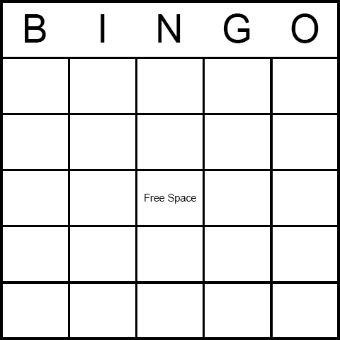
Behavior Bingo
http://www.bingocardprinter.com/bingo_blank.php

Slide 22
Lottery
Pick a desired behavior (i.e. sitting in seat at beginning of lesson without talking, standing in line, getting homework in on time)
Give out tickets at random times or on cues
Give a ticket based on who is doing the desired behavior with no punishment for those who are not doing the desired behavior
Hold lottery at end of day or end of week for a prize
Notes:
Use for paying attention or engagement
Tell Sombrero Story
Finding the right reinforcer
Use a toaster – use garage sales, concert tshirts

Slide 23
Token Economy
When all else fails – After less intrusive strategies have been found not to work
Identify target behaviors
List possible rewards
How are tokens rewarded
What does the child have to do to get a token
What will each reward “cost”
Make sure that you have the items on hand
Fade out the token economy as behavior gets better

Slide 24
Hero Procedure
Used with one student
Set up a program with a student to reach goals
Once the student reaches the goal, the entire class gets a prize, thus making the student who earned them the prize a “hero”
Can use the class to positively reinforce when he does well

Slide 25
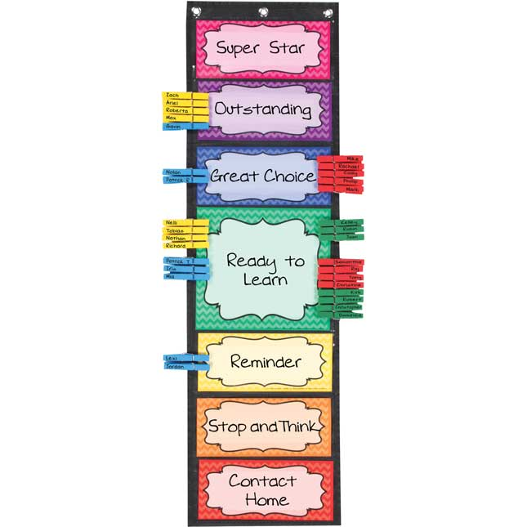
Clip Charts
Yay or Nay or Ugh?
Reverse it

Slide 26
CONTACT INFORMATION
Matt McNiff, Ph.D.
mattmcniff@yahoo.com
mmcniff@esu5.org
Twitter @mattmcniff

