Slide 1
Behavior is Communication
What is it telling you?

Slide 2
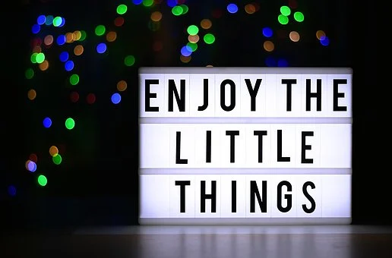

Slide 3
Participant Expectations
Be Respectful
Follow along
Be Safe
Make yourself comfortable and take care of your needs
Be Responsible
Participate fully
Plan to try out new ideas

Slide 4
“Target” Objectives
Behavior is Communication
Think functionally about behavior
Develop mini behavior plans

Slide 5
Think functionally about behavior...
Almost all behavior has a porpoise!

Slide 6
Behavior basics…
Behavior is learned-
If a student is having a behavior you don’t like- somehow/ some time/ some way/ someone “taught” & reinforced the behavior was okay… it worked…
Get curious, not furious

Slide 7
FUNCTION
All behavior serves a purpose/ has a payoff

Slide 8
TWO BASIC FUNCTIONS:

Slide 9
Escape/ Avoid

Slide 10
Obtain/ Escape
Items
Tasks
“Places”

Slide 11
Obtain/ Escape
…or DON’T
ME!
Peer Attention
Adult Attention

Slide 12
Obtain/ Escape
Sensory Stimulation

Slide 13
Functions of Behavior
Function/ purpose of behavior
Obtain
Attention
TANGIBLE
(items, tasks, places)
Sensory
Escape

Slide 14
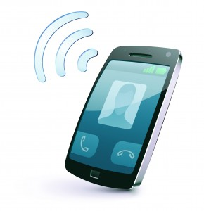
Pleasant conversation
Friend
Avoid unpleasant conversation
800 #

Slide 15
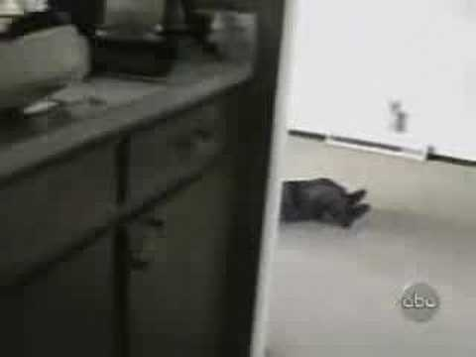
Hmmm, what could be the function of this behavior?

Slide 16
Behavior is communication!

Slide 17
When we try to pick out anything by itself, we find that it is hitched to everything else in the universe. John Muir

Slide 18
Behavior Chain
Our job…

Slide 20
Activity
Explain the two basic functions of behavior to one another using your diagram.

Slide 21
SIMPLE Functional Assessment
A-B-C, it’s easy as
Collect and analyze data
Develop A-B-C behavior pathway
Determine function

Slide 22
First: the ABC Pathway
Behavior
Consequence
Setting Event
Sets the stage
Antecedent
Trigger

Slide 23
Behavior: MOO
Measurable
Observable
Objective

Slide 24
Practice Identify the behavior, antecedent, consequence, and function in each scenario.
Consequence/Outcome:
and as a result…
Therefore, the function of the behavior is to: get/avoid
Antecedent/Trigger:
When _______
Behavior:
The student does __________
Scenarios adapted from www.basicfba.com
Notes:
‹#›

Slide 25
Scenario
When asked to sit with his peers in morning circle, Billy pokes the students sitting next to him with his finger. The teacher sits down next to Billy on the carpet and rubs his back to get him to stop.
Antecedent/Trigger:
“When …
Behavior:
Student does…
Consequence/Outcome:
and as a result…
Therefore, the function of the behavior is to: get/avoid
Pokes the students sitting next to him with his finger

Slide 26
Activity
Share your description of the behavior. Please do not use student names.
Ask clarifying questions, if needed. Would you be able to see it, hear it, and know it when you walked in the room as a complete stranger?

Slide 27
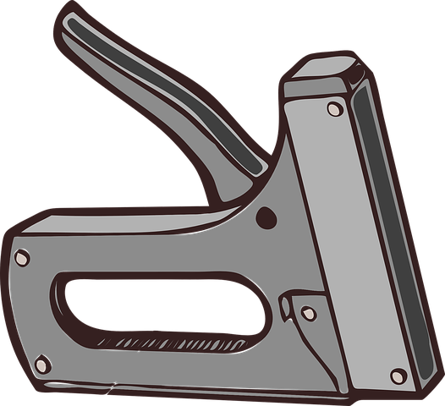
Antecedents (fast triggers)
Time of day
People
Settings
Activities

Slide 28
Common Antecedents
Transition
Given a direction
New task
Interaction with certain peer/ staff
Staff attention to another
Waiting
Told no
Seated by certain peers/ staff
Unstructured activity
Certain content area (e.g. math, reading, etc.)
Certain type of activity (e.g. whole group, small group, independent seat work)

Slide 29
Scenario
When asked to sit with his peers in morning circle, Billy pokes the students sitting next to him with his finger. The teacher sits down next to Billy on the carpet and rubs his back to get him to stop.
Antecedent/Trigger:
“When …
Behavior:
Student does…
Consequence/Outcome:
and as a result…
Therefore, the function of the behavior is to: get/avoid
Asked to sit with peers during morning circle
Pokes the students sitting next to him with his finger

Slide 30
Remember…this is a misnomer
CONSEQUENCE=
Bad unpleasant
bummer
Hurt not good loss
Dreadful unlikable terrible

Slide 31
Common “consequences”
Staff member walks over and talks to the student; sits next to the student
Peers laugh
Staff member tells the student to stop
Student is ignored
Staff reprimands student
Student walks out without permission
Peers move away from student
Student doesn’t do assignment/ activity
Gets access to computer/ preferred activity

Slide 32
Scenario
When asked to sit with his peers in morning circle, Billy pokes the students sitting next to him with his finger. The teacher sits down next to Billy on the carpet and rubs his back to get him to stop.
Antecedent/Trigger:
“When …
Behavior:
Student does…
Consequence/Outcome:
and as a result…
Therefore, the function of the behavior is to: get/avoid
Teacher sits next to him & rubs his back
Asked to sit with peers during morning circle
Pokes the students sitting next to him with his finger
Adult attention

Slide 33
Setting Events
Up late at night
Missed breakfast
Frustration with academic work
Change in daily routine
Nightmares
Missed medication
Illness

Slide 34
Activity
Share each person’s behavior chain. Ask questions, as needed. Does the behavior chain make sense? Please do not use student names.

Slide 36
Develop a Mini
Behavior Plan
Intervention Bank

Slide 37
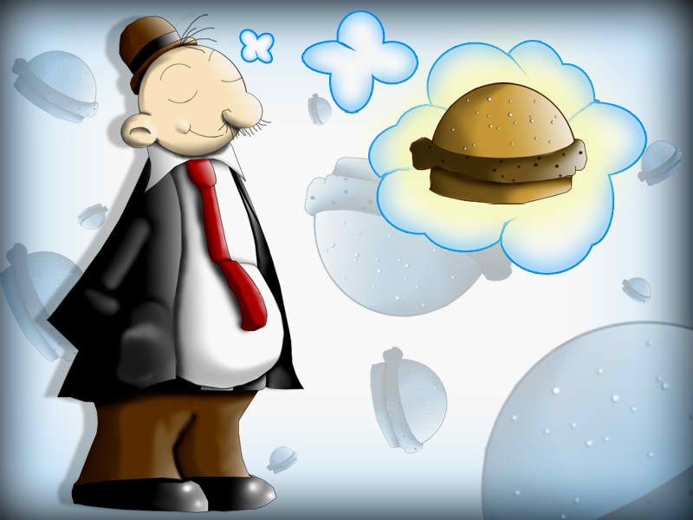
Intervention
All Wimpy can ever think about is hamburgers, not school.
What intervention might help here?

Slide 38
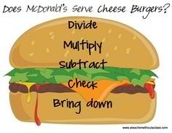
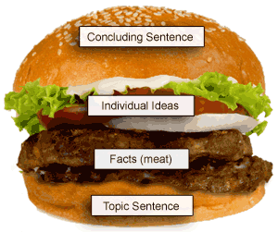
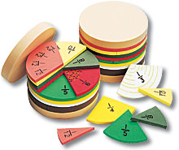
Intervention

Slide 39
Intervention
Modify Antecedents (triggers)
Music

Slide 40
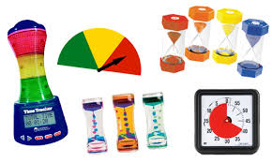
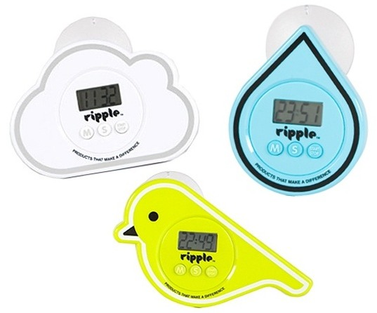
Intervention
Modify Antecedents (triggers)
Timers

Slide 41
Intervention
Modify Antecedents- Prompts and Precorrects
What is precorrection?
Following initial instruction, a staff member anticipates possible behavioral errors based on past history and then provides the student/s with a prompt regarding appropriate behavior.
Precorrection is prevention!

Slide 42
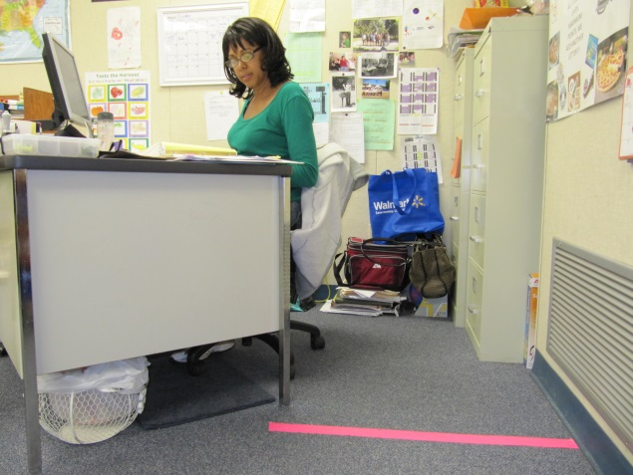
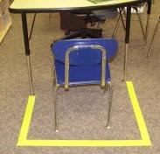
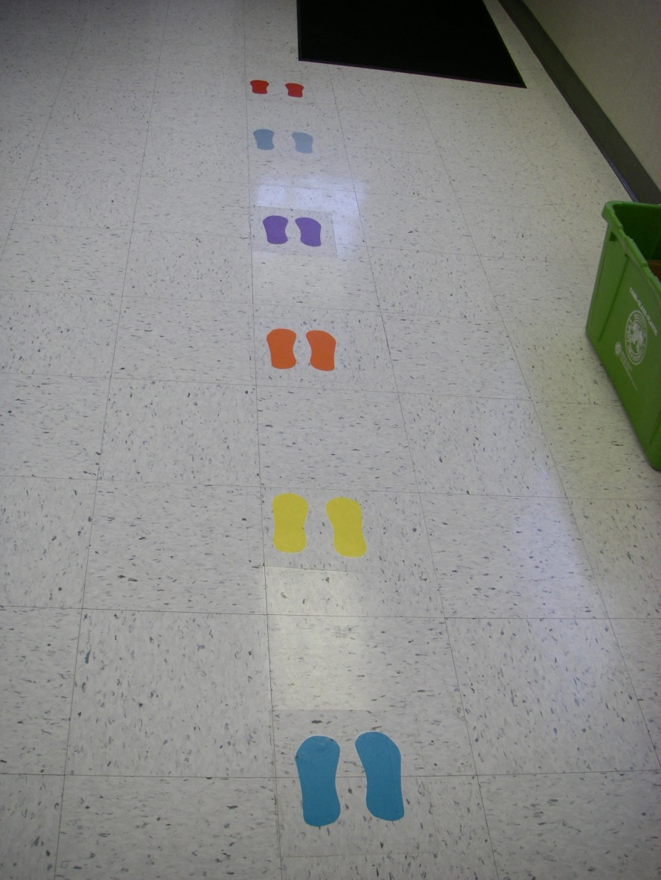
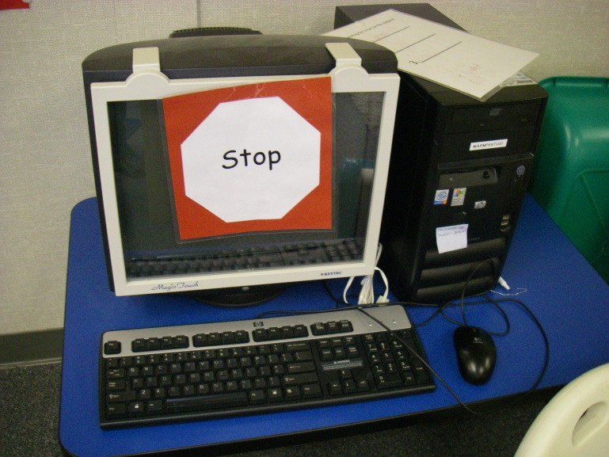
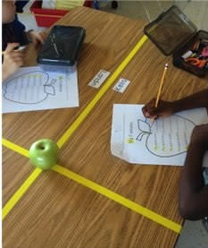
Intervention
Modify Antecedents
Increase/ individualize visual cues

Slide 43
Intervention
Write pre-emptive notes:
Liz, remember to raise your hand to offer an answer or comment.

Slide 44
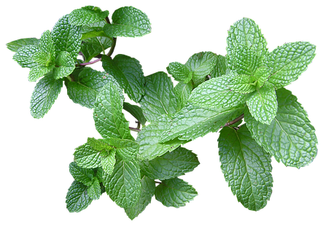
Intervention
Modify Antecedents
Mint is a natural stimulant and decreases fatigue
Lavender decreases anxiety, insomnia, depression, and restlessness

Slide 45
Intervention
Modify Antecedents
and nonverbal signals

Slide 46
Intervention
Modify Antecedents

Slide 47
The Two-By-Ten Intervention (Mendler, 2000)
Intervention
Modify Antecedents
Make a commitment to spend 2 minutes per day for 10 consecutive days in building a relationship with a student…by talking about topics of interest to the student. Avoid discussing problems with the student’s behaviors or schoolwork during these times.

Slide 48
Use behavioral momentum…
Intervention
have the student engage in a series of activities they are likely to comply with (e.g., passing out papers) before placing demands they are less likely to comply with…

Slide 49
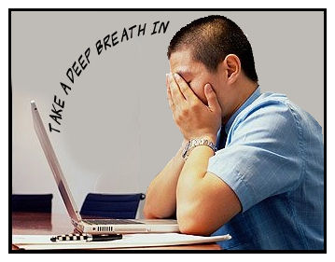
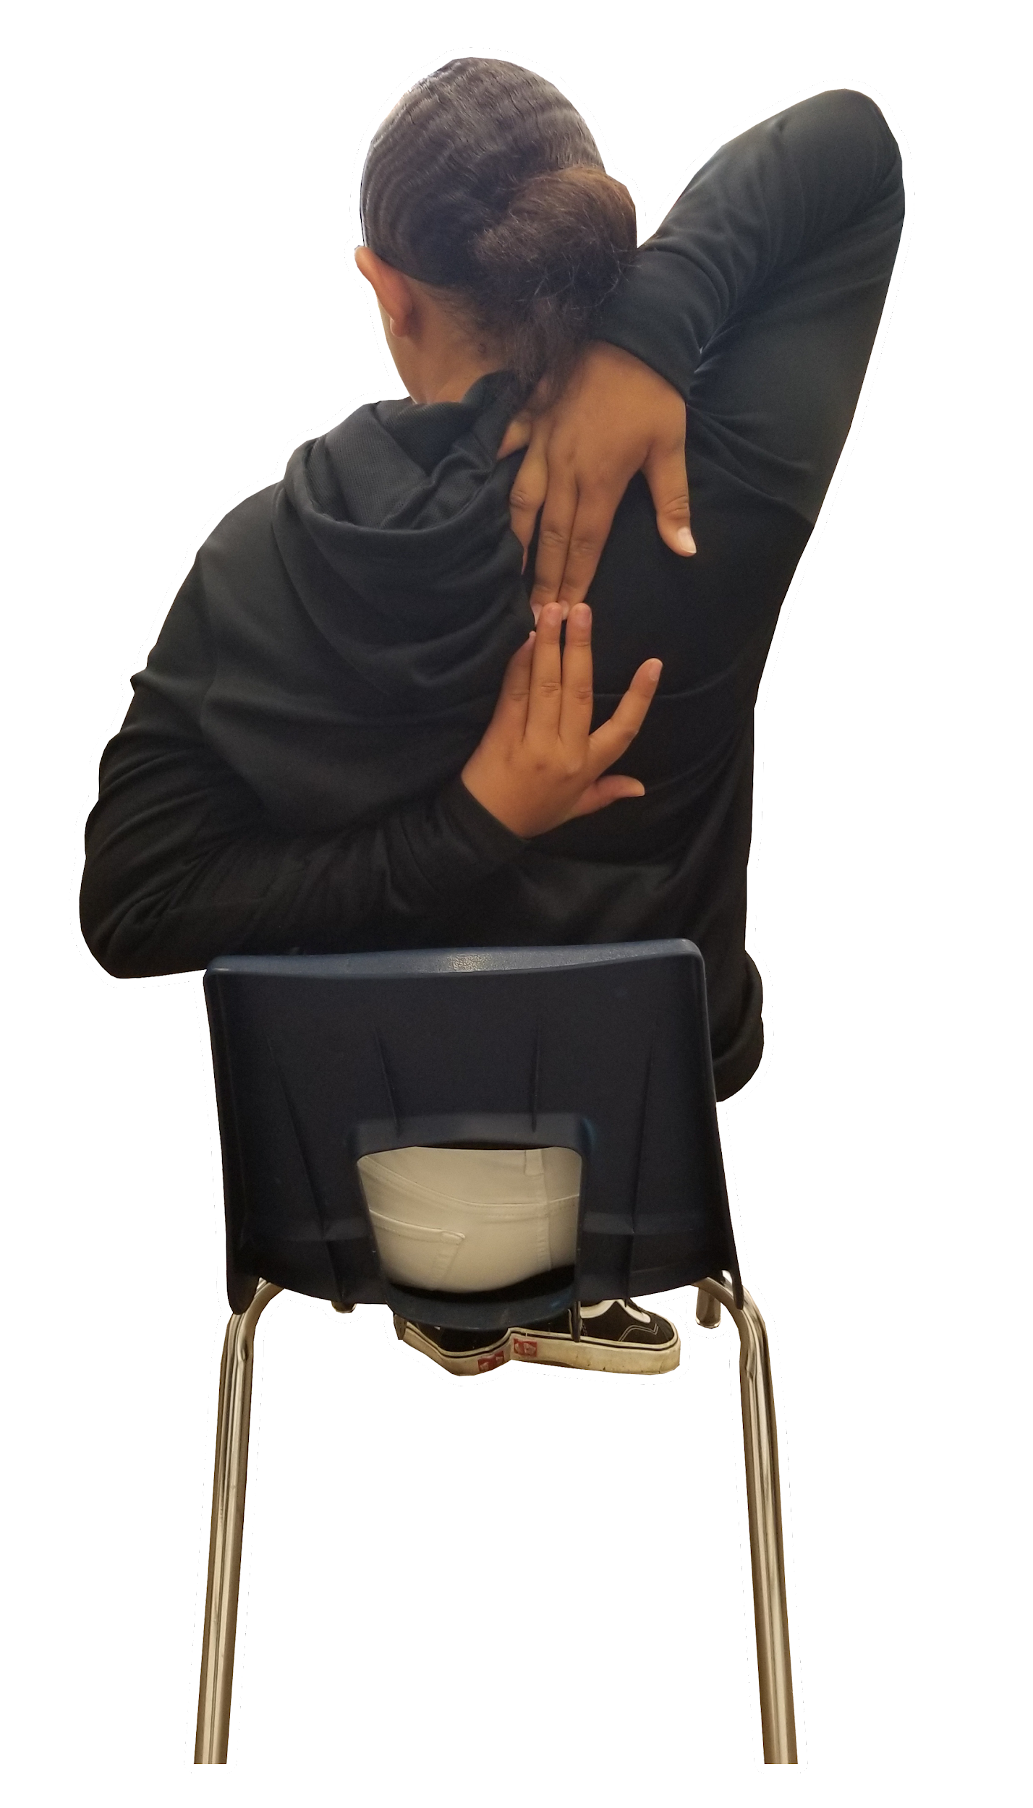
Intervention
Behavior Teaching Strategies
Relaxation

Slide 50
Intervention
Behavior Teaching Strategy
Looking at pictures of nature calms us and improves cognitive performance

Slide 51
Intervention
Behavior Teaching Strategy
The Incredible 5 Point Scale (Buron & Curtis, 2003)

Slide 52
Intervention
Behavior Teaching Strategy
Reduces stress and anxiety
Reduces tension and anxiety

Slide 53
Intervention
Behavior Teaching Strategy

Slide 54
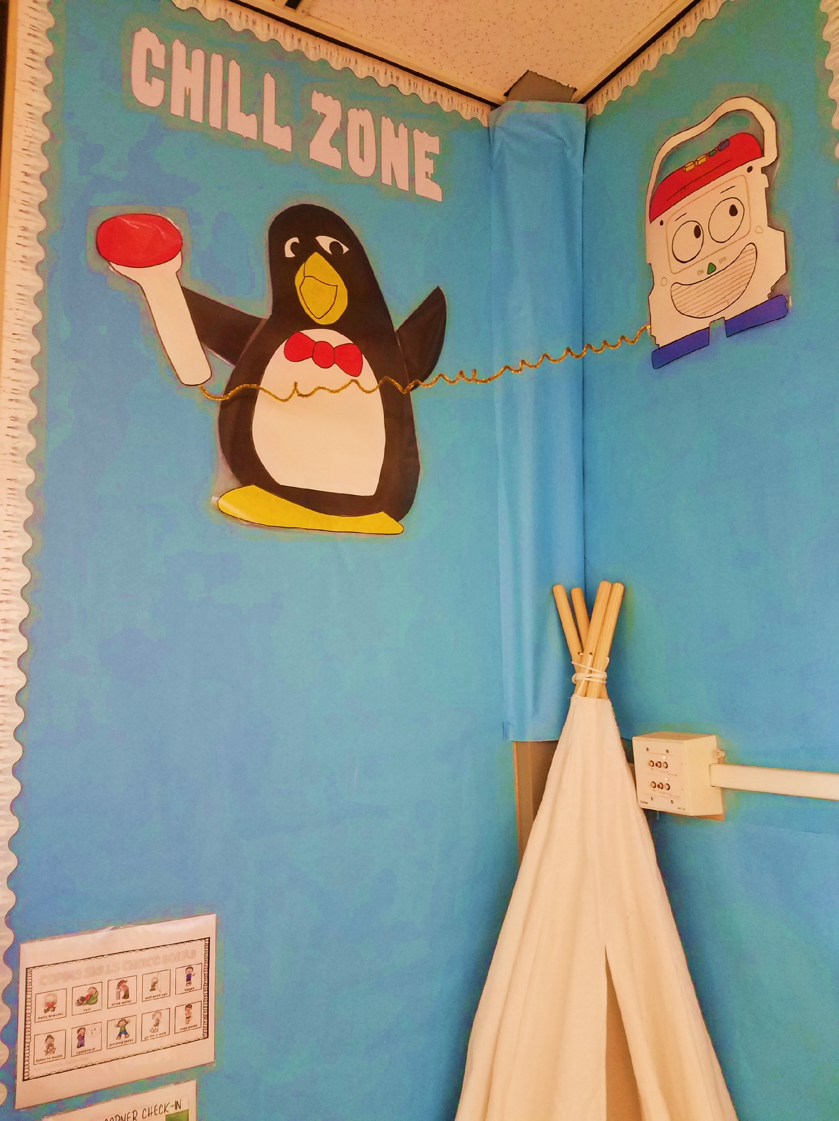
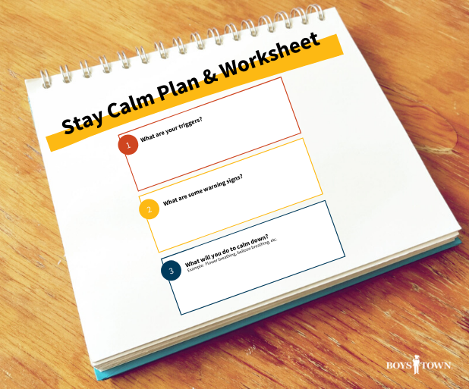
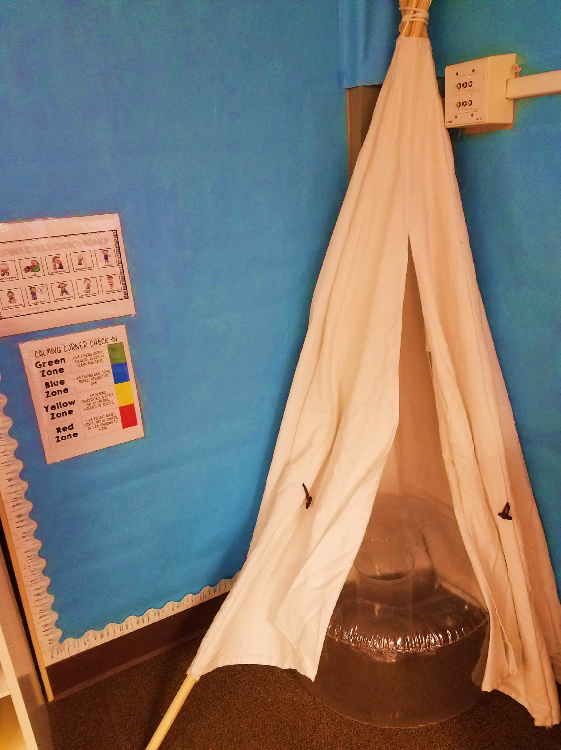
Intervention
“Cool Down Time”
“Safe Places”

Slide 55
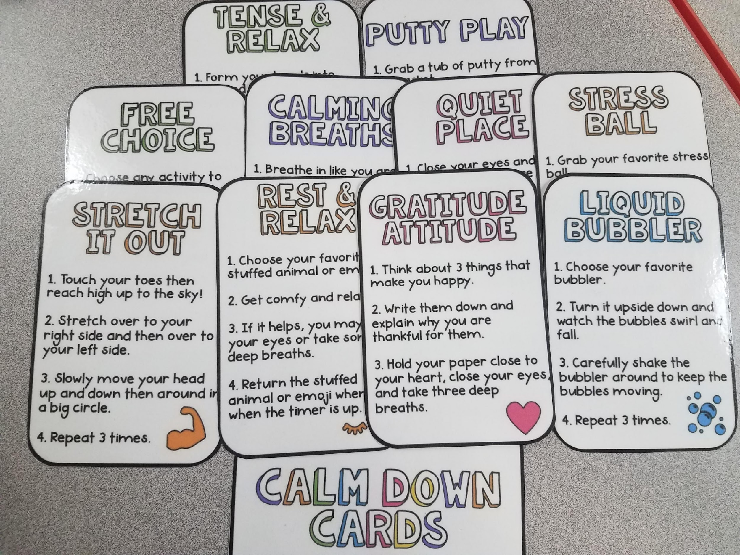

Slide 56
Intervention
Make a mindfulness glitter jar

Slide 57
Intervention
Behavior Teaching Strategy
Wiggling your fingers and toes has two health benefits: decreases insomnia AND helps you wake up

Slide 58
Intervention
Behavior Teaching
Strategy
Comic Strip Conversations

Slide 59
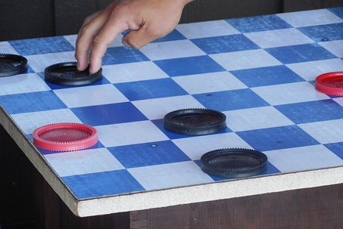
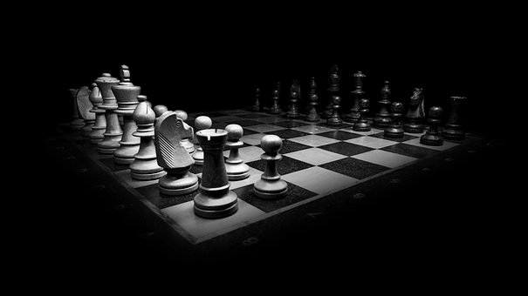
Intervention
Behavior Teaching Strategy
Playing games enforces the concept of rules and having to follow them, encourages children to think and plan ahead, and fosters the social skills of turn taking and winning or losing gracefully.

Slide 60
YOGA
Intervention

Slide 61
Intervention
Attention Strategy

Slide 62
Intervention
Attention Strategy:
Mentors

Slide 63
Intervention
Attention Strategy
Peer tutoring

Slide 64
Intervention
Attention Strategy

Slide 65
Intervention
Escape (work, peers, sounds) Strategy
A place to
cool down/
chill out

Slide 66
Intervention
Escape Strategy
Clay Cook

Slide 67
Class Pass steps
Teacher gives the student the daily allotment of passes
Student requests a pass as needed
Student appropriately takes a break
Student selects reinforcement for unused passes

Slide 68
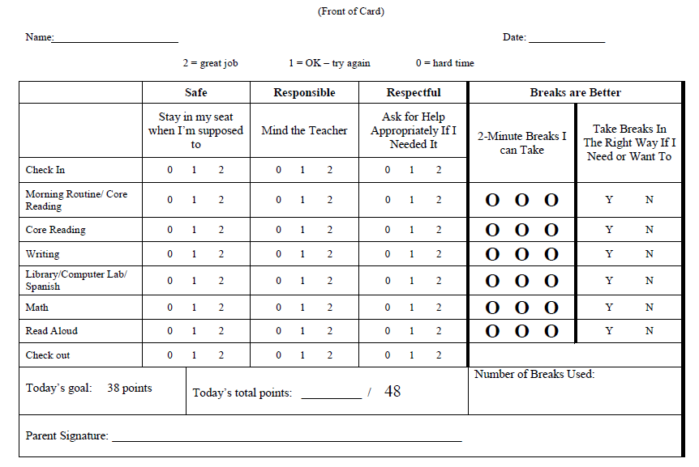
Intervention
Escape Strategy

Slide 69
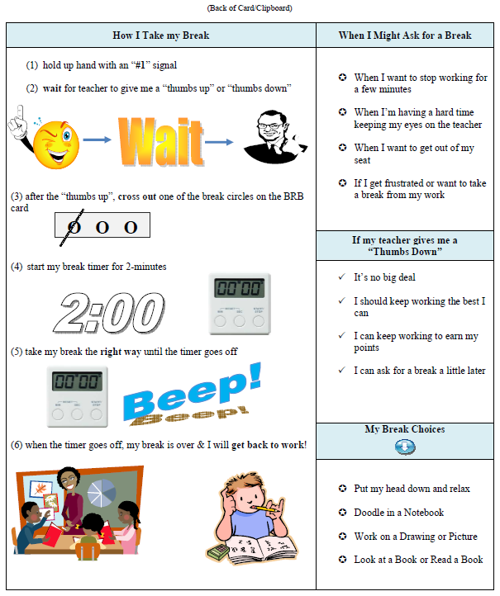
Cynthia Anderson, Justin Boyd

Slide 70
Intervention
Escape Strategies
Modify task to increase interest
Chunk tasks
Intersperse preferred and non-preferred tasks
Shorten tasks (e.g. all the odds, all the evens)
Break down directions

Slide 71
Intervention
Sensory Strategy
Fidgets

Slide 72
Intervention
Sensory Strategy
Standing desks
Ball chairs
Seat cushions
Bouncing bars

Slide 73
Intervention
Sensory Strategy

Slide 74
Intervention
Attention/ consequence strategies
Secret Signal

Slide 75
Intervention
Consequence Strategy
Quietly offer 2 equal choices to right ear: “You can do this__ or this__”

Slide 76
Intervention
Antecedent/ consequence strategy
Choices

Slide 77
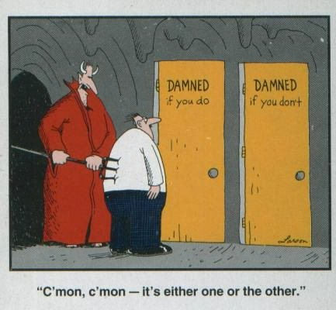
Intervention

Slide 78
Activity
Develop a mini behavior plan

Slide 79
The Matching Law of Behavior
Simply put, we tend to engage in more of the behavior that produces the highest levels of reinforcement, and less of the behavior that produces less reinforcement.
minimize
MAXIMIZE
Notes:
Mantras. One year “go beyond the checklist”, another year “minimize attention to the unwanted behavior; maximize attention for desired behavior.”

Slide 80
Intervention
What typically happens when we intervene?
It takes time to change behavior
One month of CONSISTENT implementation per year of behavior
Behavior may get worse before it gets better
“Up the ante”
Spontaneous recovery
Temporary reoccurrence

Slide 81
“Target” Objectives
Behavior is Communication
Think functionally about behavior
Develop mini behavior plans

Slide 82
One take away from today...

Slide 83
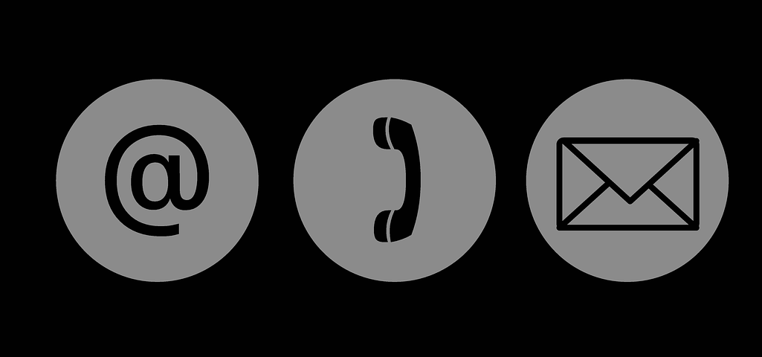
Heather Robbins
hldrobbins@gmail.com
@hldrobbins
505-402-6142
https://www.hrobbins.com/

